Slide 1
Network Theorems

Slide 2
Network Theorems: Introduction
A disadvantage of using Kirchoff’s Laws is that, for a large, complex circuit, tedious computation is involved.
Network theorems are used to reduce a complex circuit to a simpler one, thereby making circuit analysis much simpler.
The theorems that are most useful in analysing networks are the superposition, Thévenin, Norton, and maximum power transfer theorems.
Since these theorems are applicable to linear circuits, we first discuss the concept of circuit linearity.

Slide 3
Linearity Property
Linearity is the property of an element describing a linear relationship between cause and effect.
The property is a combination of both the homogeneity (scaling) property and the additivity property.
The homogeneity property requires that if the input (also called the excitation) is multiplied by a constant, then the output (also called the response) is multiplied by the same constant.

Slide 4
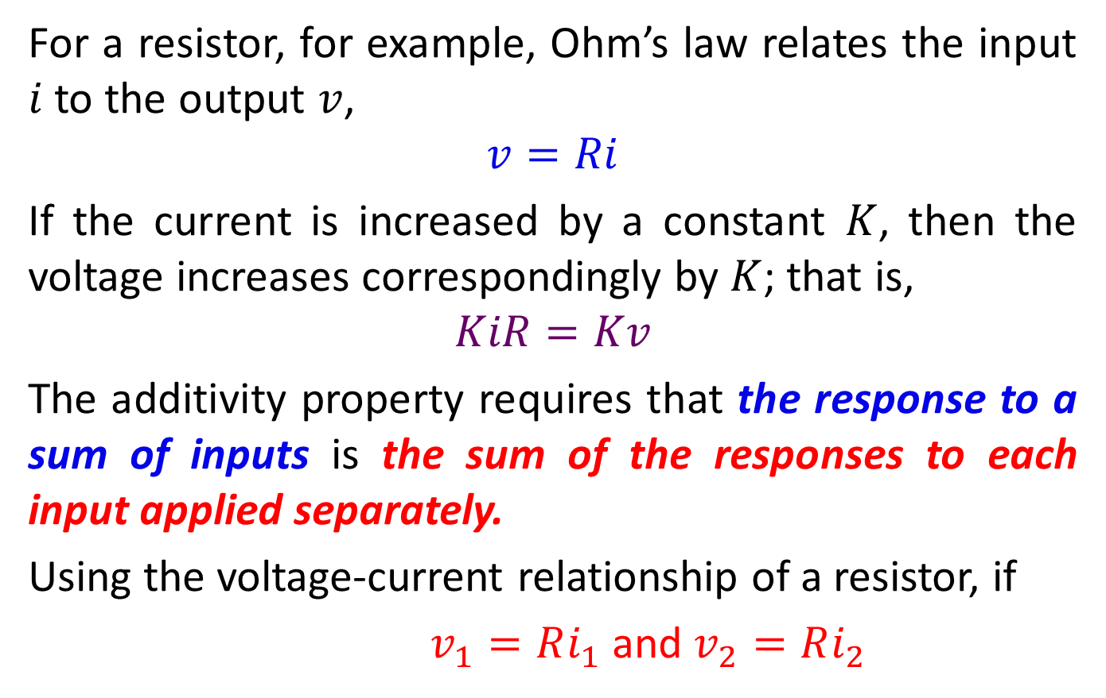
Linearity Property
For a resistor, for example, Ohm’s law relates the input $i$ to the output $v$,
$$v=Ri$$
If the current is increased by a constant $K$, then the voltage increases correspondingly by $K$; that is,
$$KiR=Kv$$
The additivity property requires that the response to a sum of inputs is the sum of the responses to each input applied separately.
Using the voltage-current relationship of a resistor, if
$v_{1}=Ri_{1}$and $v_{2}=Ri_{2}$

Slide 5
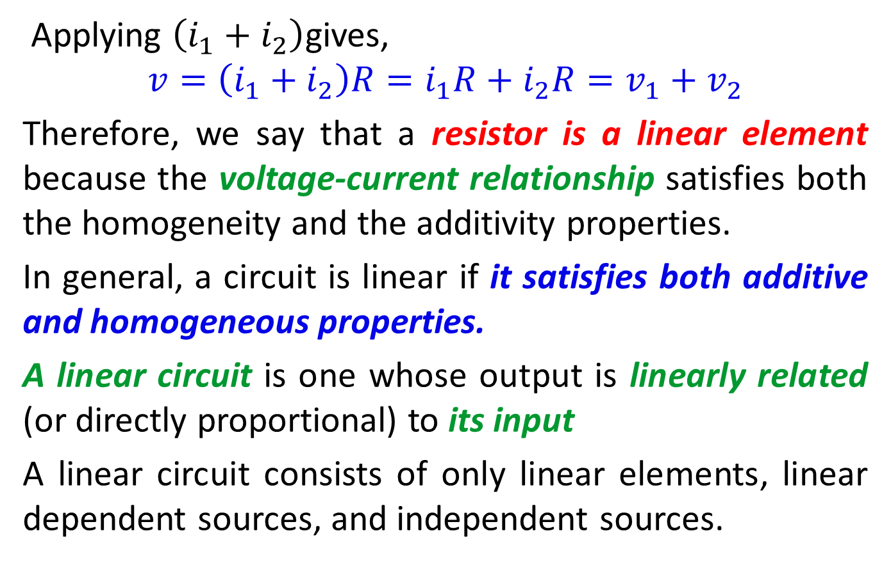
Linearity Property
Applying $\left(i_{1}+i_{2}\right)$gives,
$$v=\left(i_{1}+i_{2}\right)R=i_{1}R+i_{2}R=v_{1}+v_{2}$$
Therefore, we say that a resistor is a linear element because the voltage-current relationship satisfies both the homogeneity and the additivity properties.
In general, a circuit is linear if it satisfies both additive and homogeneous properties.
A linear circuit is one whose output is linearly related (or directly proportional) to its input
A linear circuit consists of only linear elements, linear dependent sources, and independent sources.

Slide 6
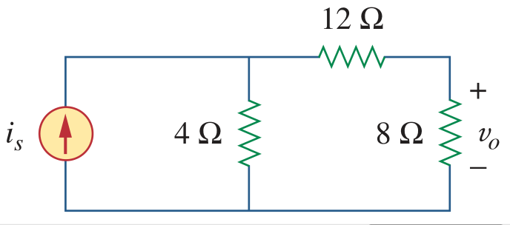
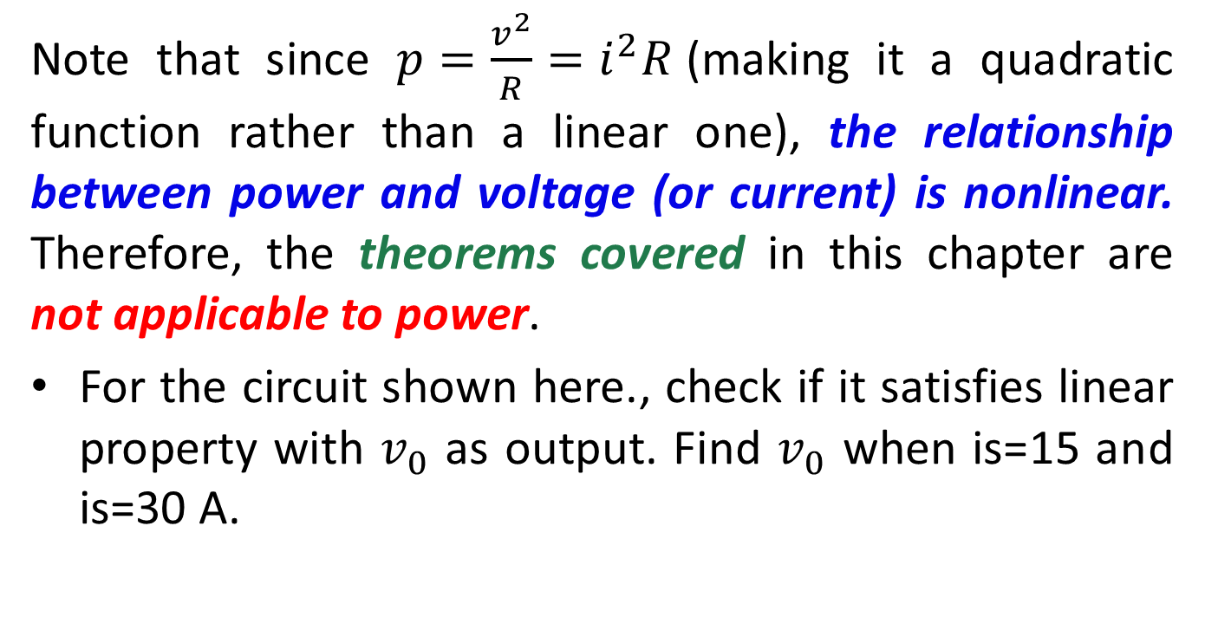
Linear Property
Note that since $p=\frac{v^{2}}{R}=i^{2}R$(making it a quadratic function rather than a linear one), the relationship between power and voltage (or current) is nonlinear. Therefore, the theorems covered in this chapter are not applicable to power.
For the circuit shown here., check if it satisfies linear property with $v_{0}$ as output. Find $v_{0}$ when is=15 and is=30 A.

Slide 7
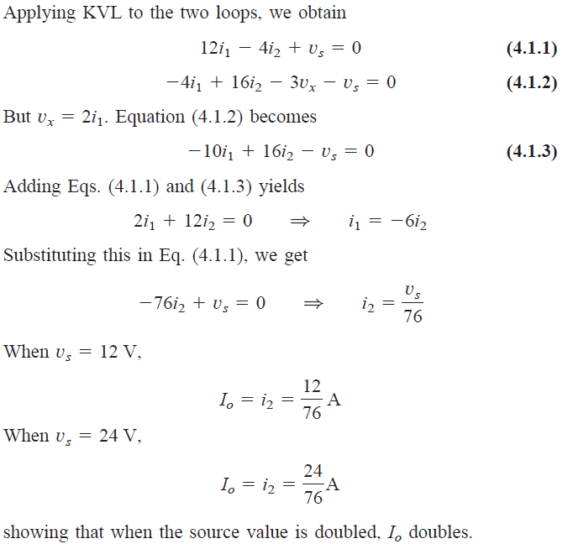
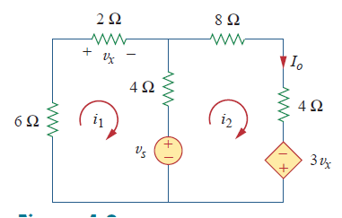
For the circuit shown in Figure, find Io when Vs=12 V and Vs=24 V.

Slide 8
Superposition Theorem
If a circuit has two or more independent sources, one way to determine the value of a specific variable (voltage or current) is to use nodal or mesh analysis.
Another way is to determine the contribution of each independent source to the variable and then add them up. This approach is known as the superposition.
The idea of superposition rests on the linearity property.

Slide 9
Superposition Theorem
The superposition principle states that the voltage across (or current through) an element in a linear circuit is the algebraic sum of the voltages across (or currents through) that element due to each independent source acting alone.
The principle of superposition helps us to analyse a linear circuit with more than one independent source by calculating the contribution of each independent source separately.

Slide 10
Superposition Theorem
To apply the superposition principle:
Consider one independent source at a time while all other independent sources are set to zero. This implies that we replace every voltage source by 0 V (or a short circuit), and every current source by 0 A (or an open circuit). This way we obtain a simpler and more manageable circuit.
Dependent sources are left intact because they are controlled by circuit variables.

Slide 11
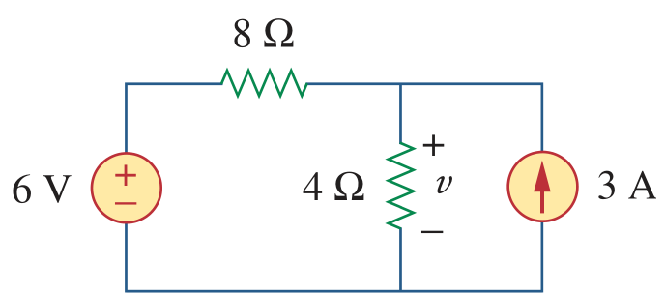
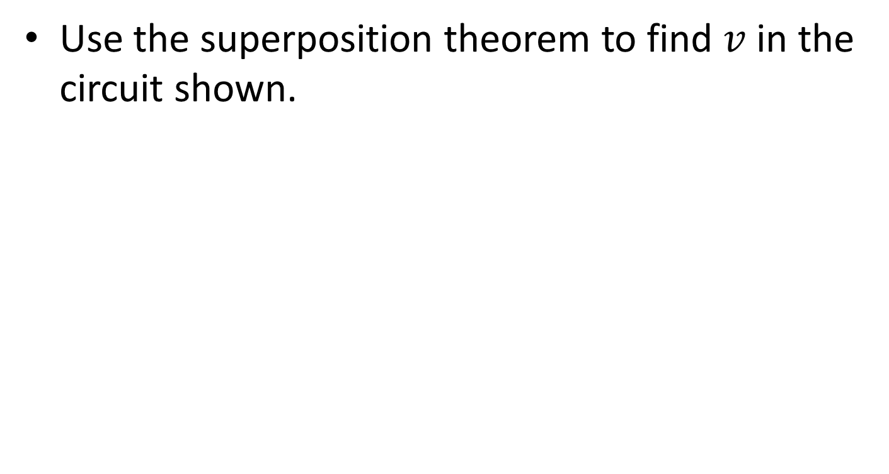
Example
Use the superposition theorem to find $v$ in the circuit shown.

Slide 12
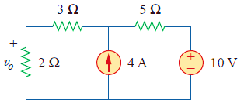
Using superposition theorem find v_{o} in the circuit shown below.
Answer: 6 V.

Slide 13
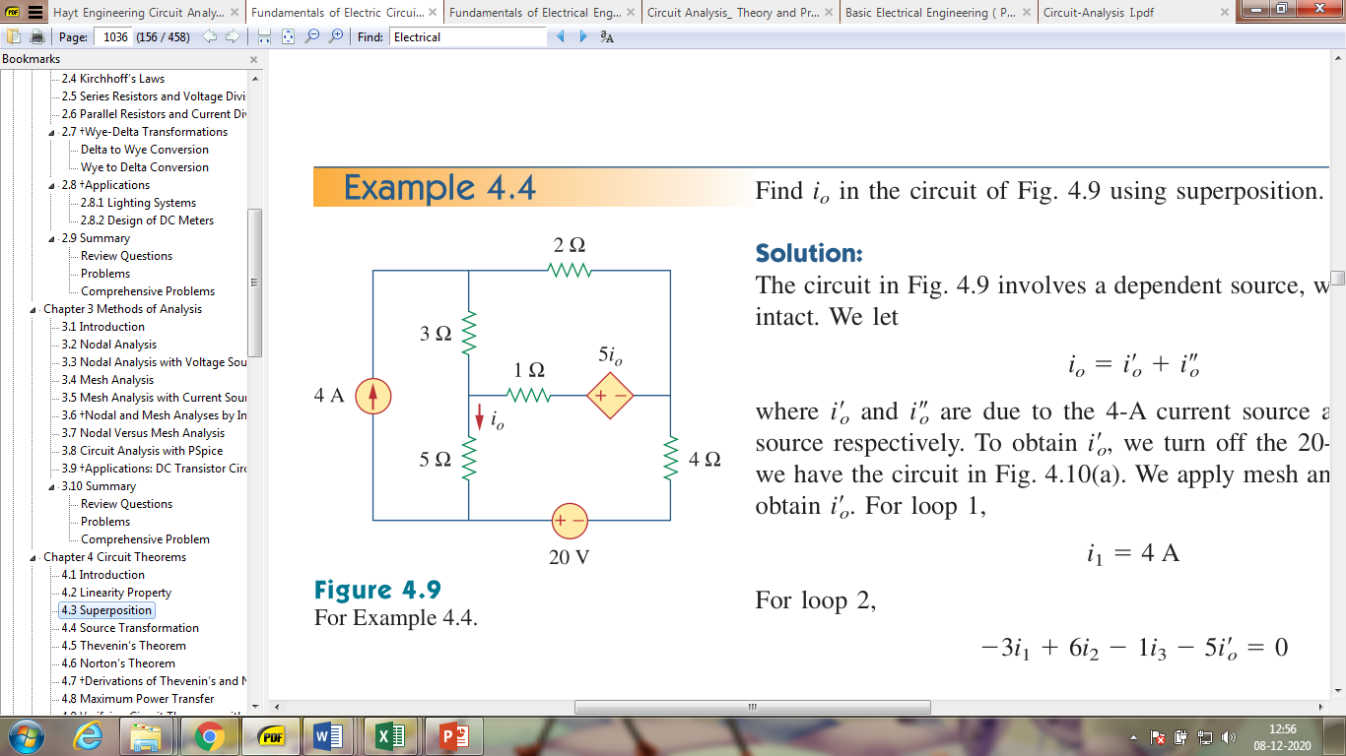
Example
Find $i_{0}$ in the circuit shown using superposition.

Slide 14
Source Transformation
Source transformation is another tool for simplifying circuits.
A common goal in source transformation is to end up with either all current sources or all voltage sources in the circuit.
An ideal independent voltage source maintains a constant voltage between its terminals regardless of the current that flows through it. But an ideal voltage source does not exist. Similarly, an ideal current source does not exist.

Slide 15
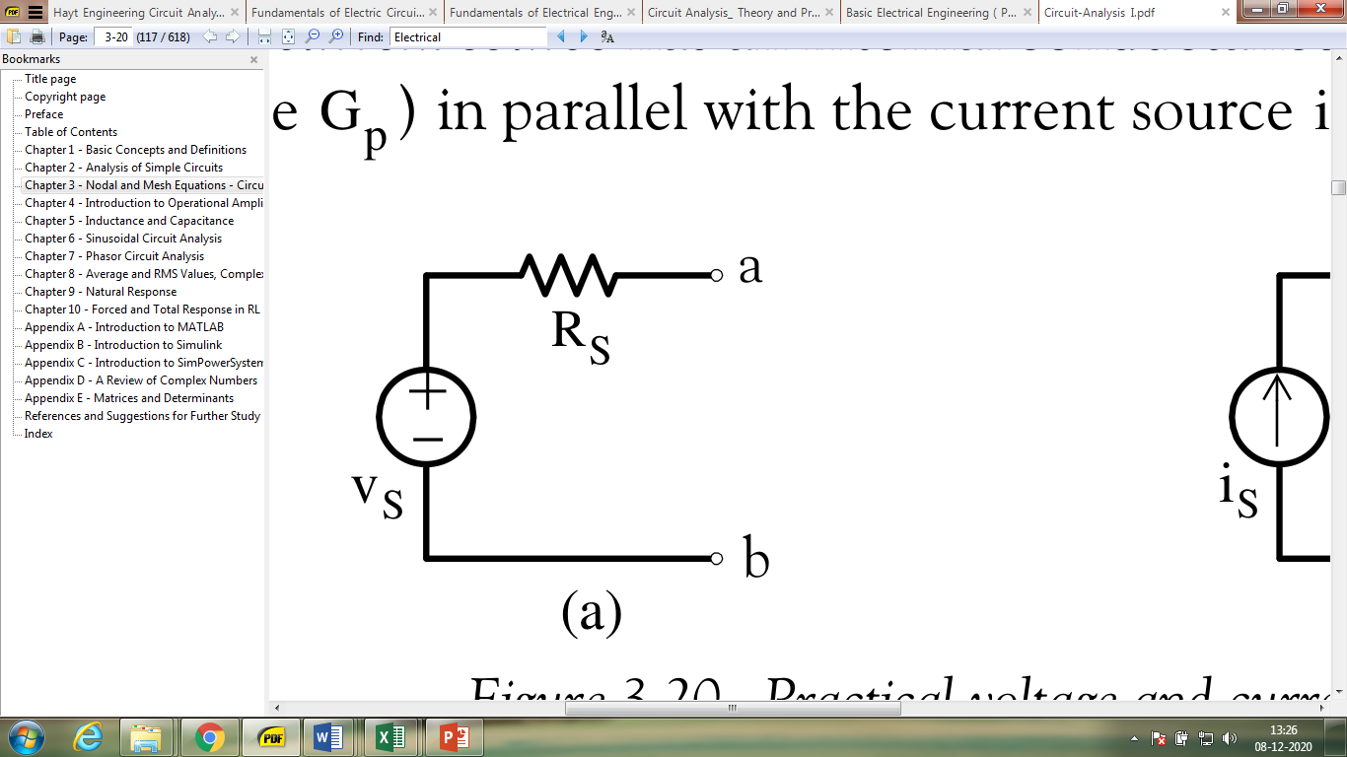
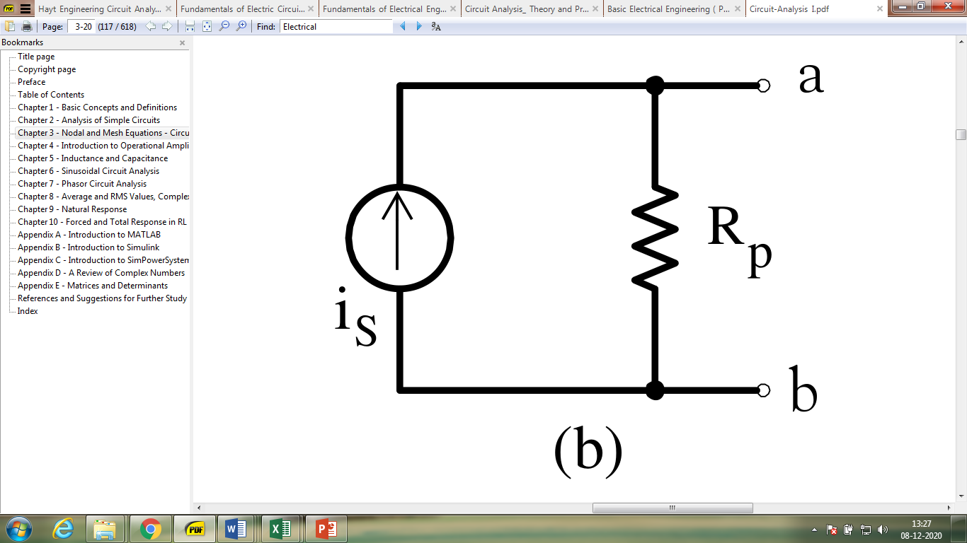
Source Transformation
A practical voltage source has an internal resistance which, to be accounted for, it is represented with an external resistance in series with the voltage source.
Likewise a practical current source has an internal conductance which is represented as a resistance (or conductance) in parallel with the current source.
Figure: Practical voltage and current sources

Slide 16
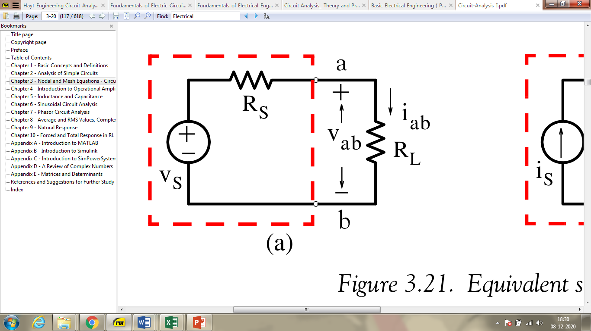
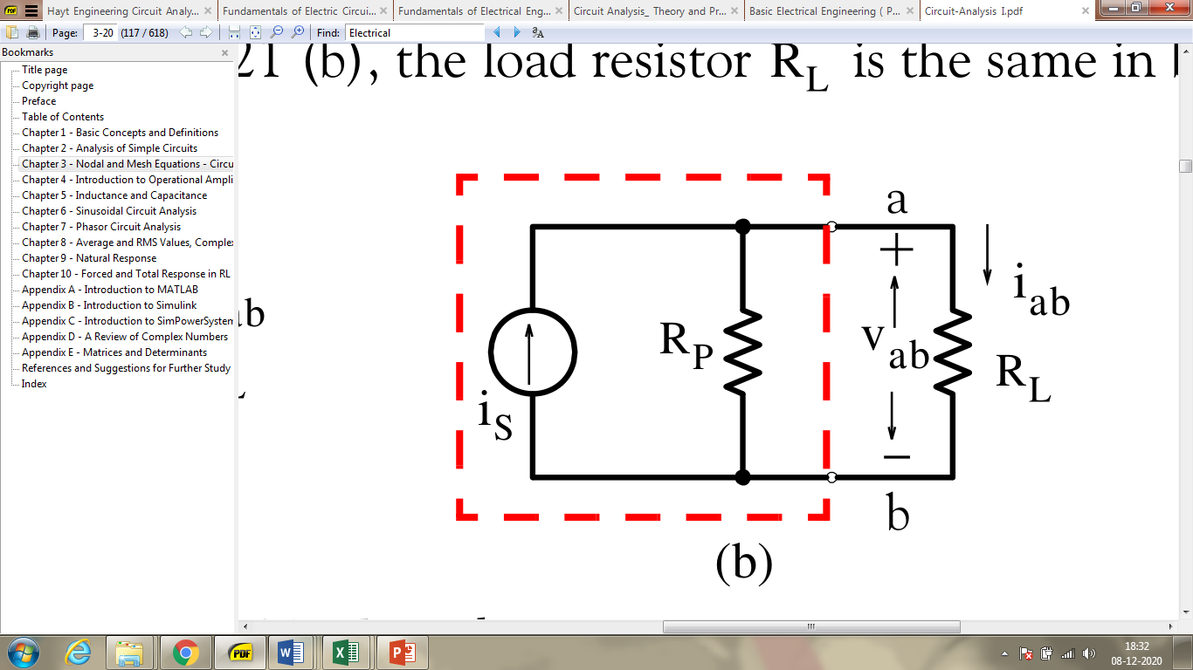
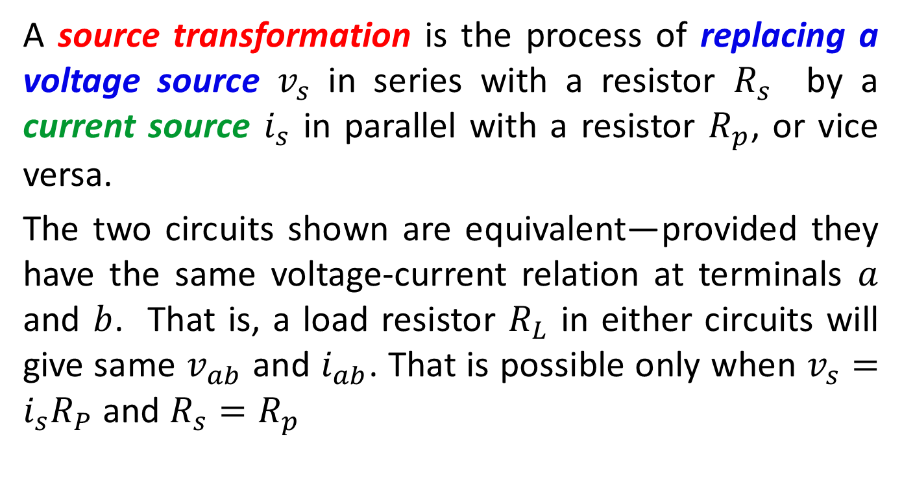
Source Transformation
A source transformation is the process of replacing a voltage source $v_{s}$ in series with a resistor $R_{s}$ by a current source $i_{s}$ in parallel with a resistor $R_{p}$, or vice versa.
The two circuits shown are equivalent—provided they have the same voltage-current relation at terminals $a$ and $b$. That is, a load resistor $R_{L}$ in either circuits will give same $v_{ab}$ and $i_{ab}$. That is possible only when $v_{s}=i_{s}R_{P}$ and $R_{s}=R_{p}$
Figure: Equivalent sources

Slide 17
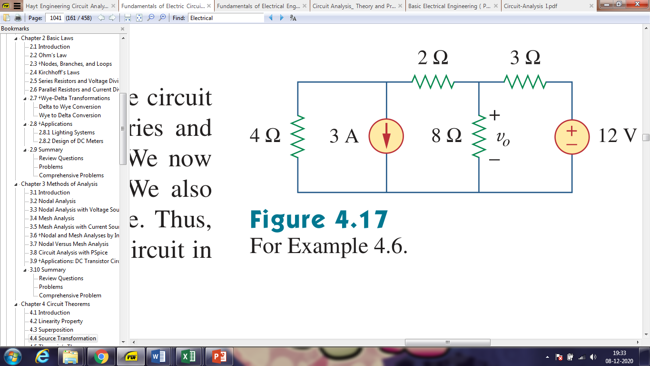
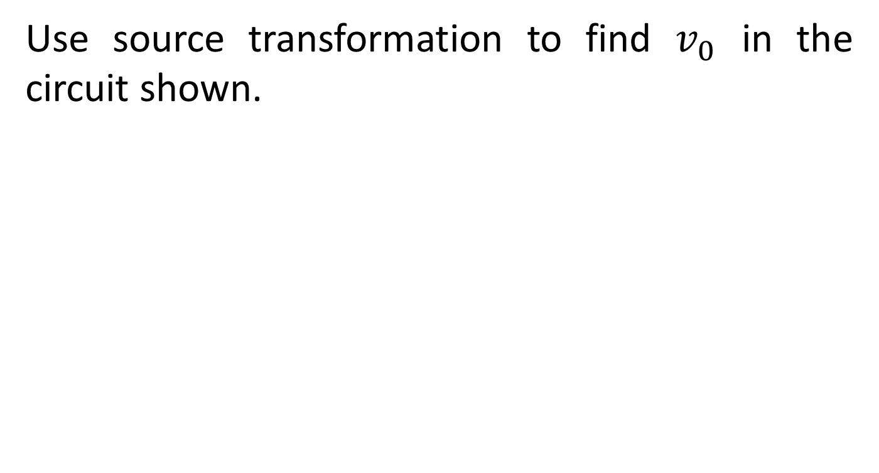
Source Transformation: Example
Use source transformation to find $v_{0}$ in the circuit shown.
Note: In a source transformation, the head of the current source arrow corresponds to the “+” terminal of the voltage source.

Slide 18
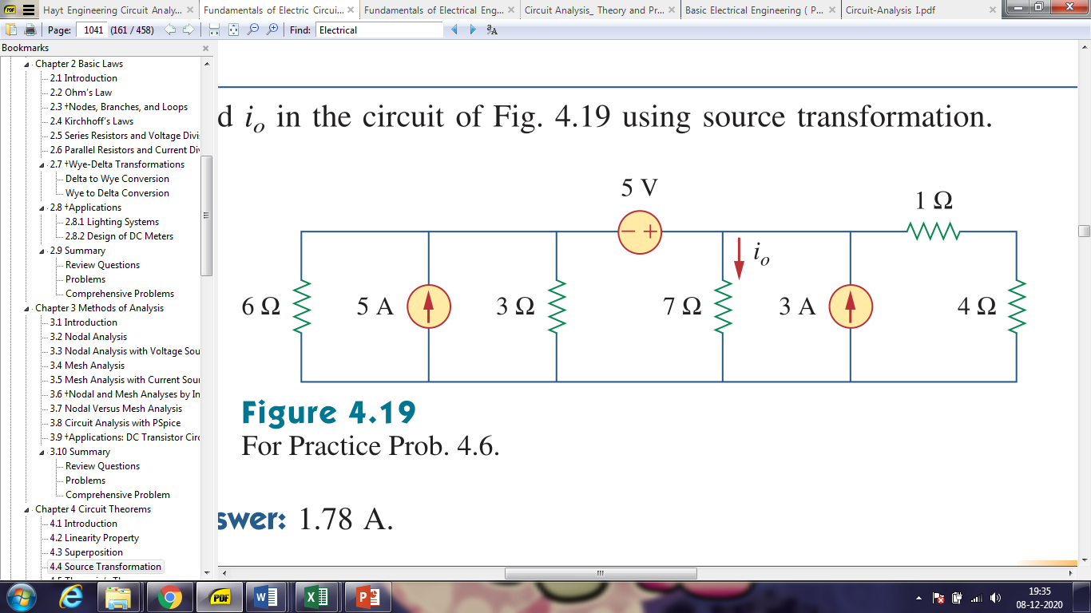
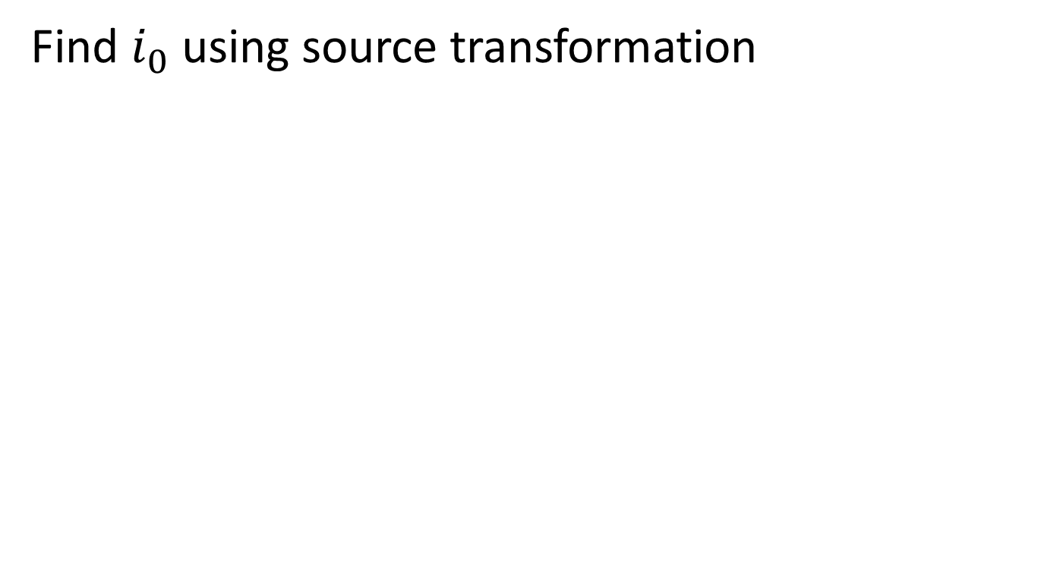
Practice Problem
Find $i_{0}$ using source transformation

Slide 19
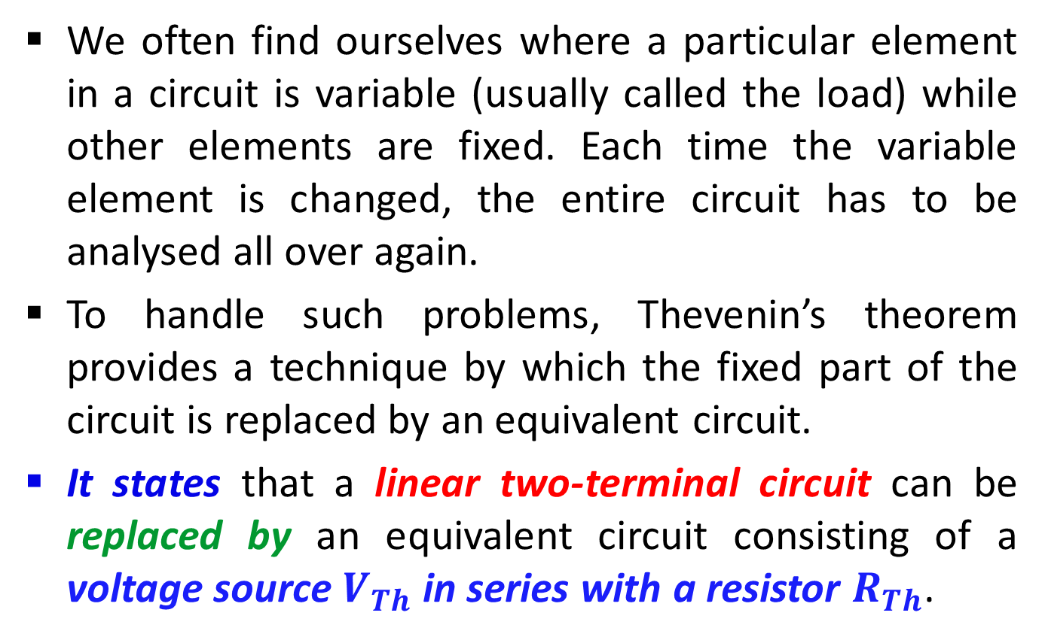
Thevenin’s Theorem
We often find ourselves where a particular element in a circuit is variable (usually called the load) while other elements are fixed. Each time the variable element is changed, the entire circuit has to be analysed all over again.
To handle such problems, Thevenin’s theorem provides a technique by which the fixed part of the circuit is replaced by an equivalent circuit.
It states that a linear two-terminal circuit can be replaced by an equivalent circuit consisting of a voltage source $V_{Th}$ in series with a resistor $R_{Th}$.

Slide 20
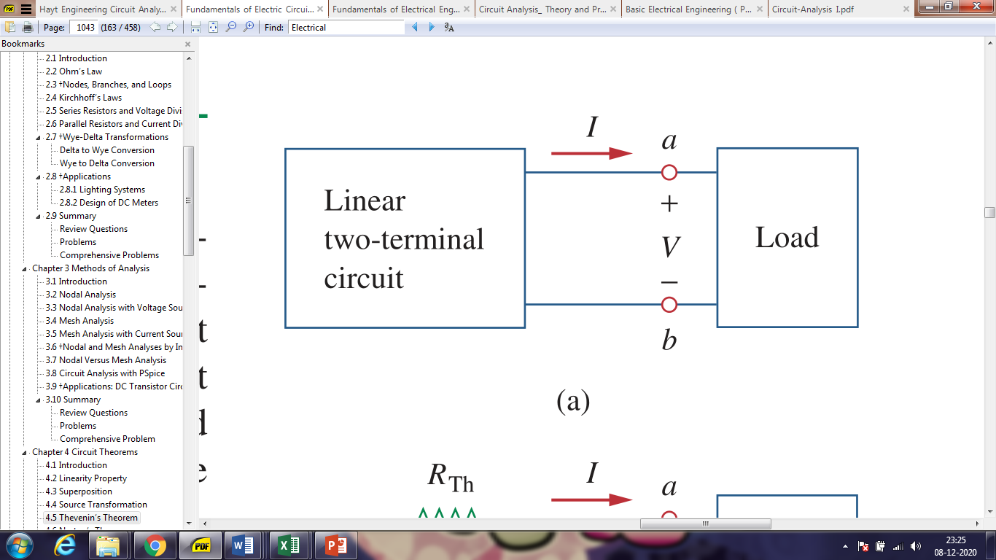
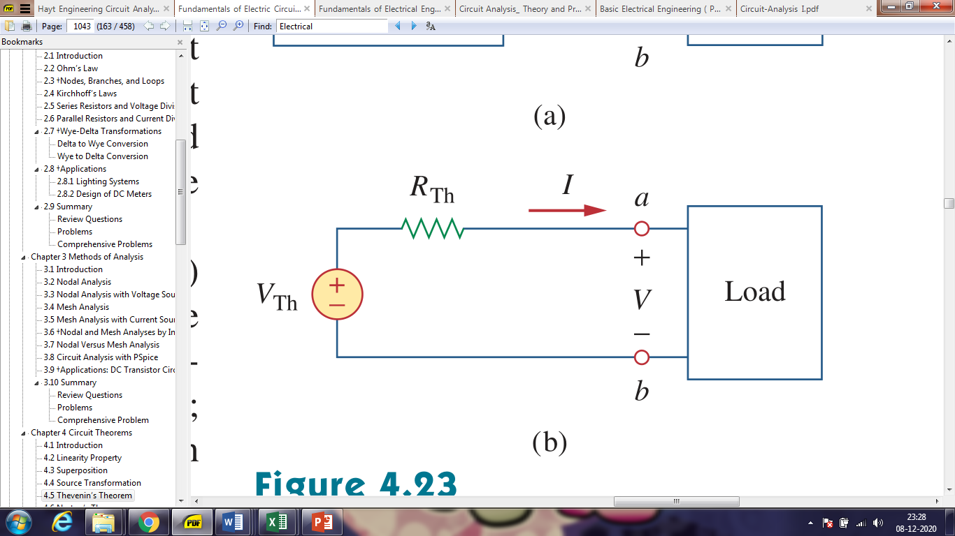
Thevenin’s Theorem
Figure: Replacing a linear two-terminal circuit by its Thevenin equivalent: (a) original circuit, (b) the Thevenin equivalent circuit.

Slide 21
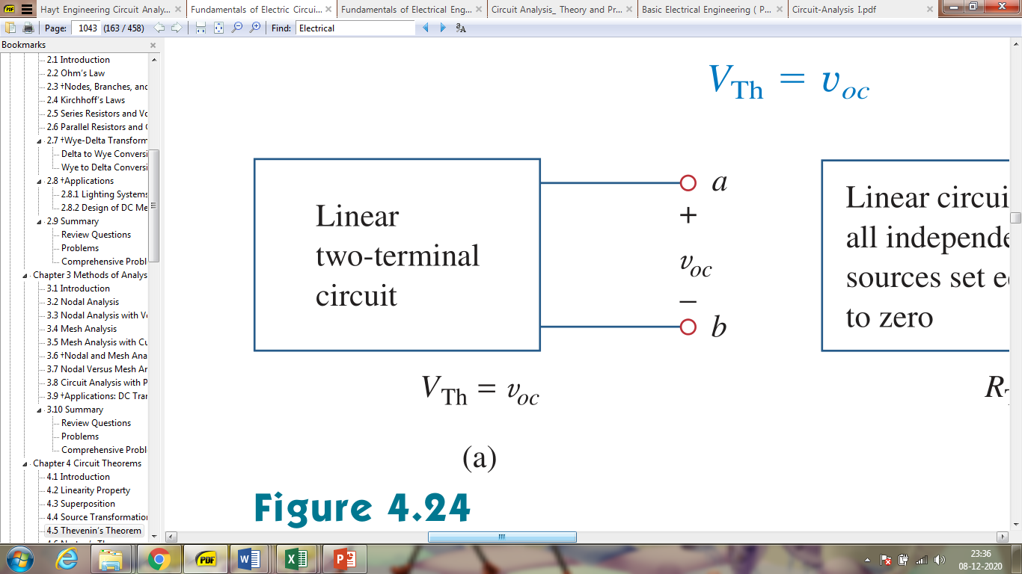
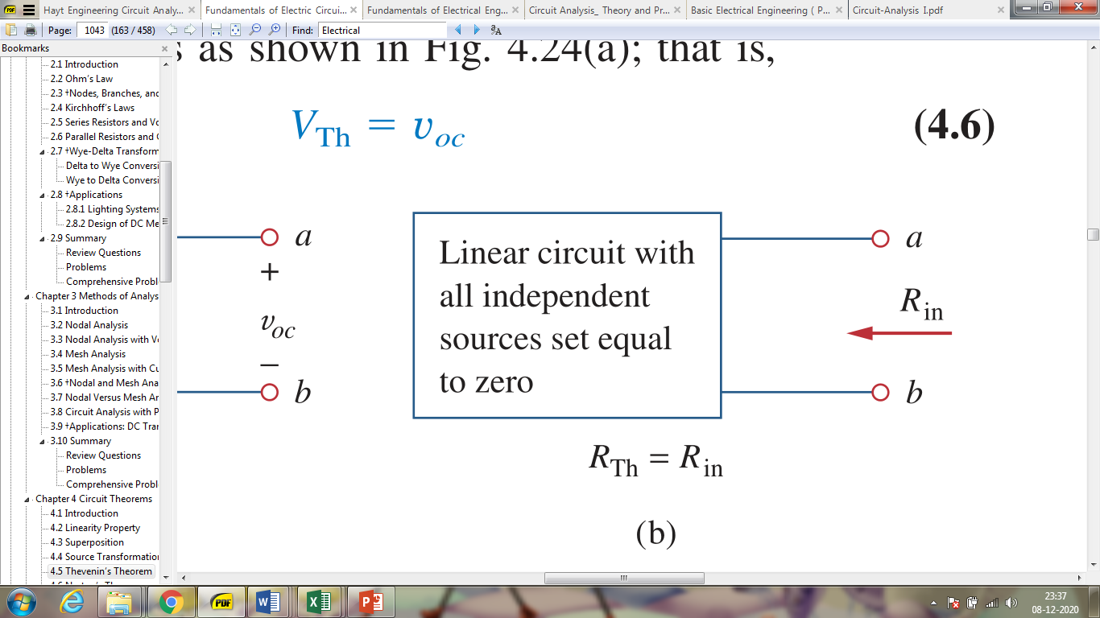
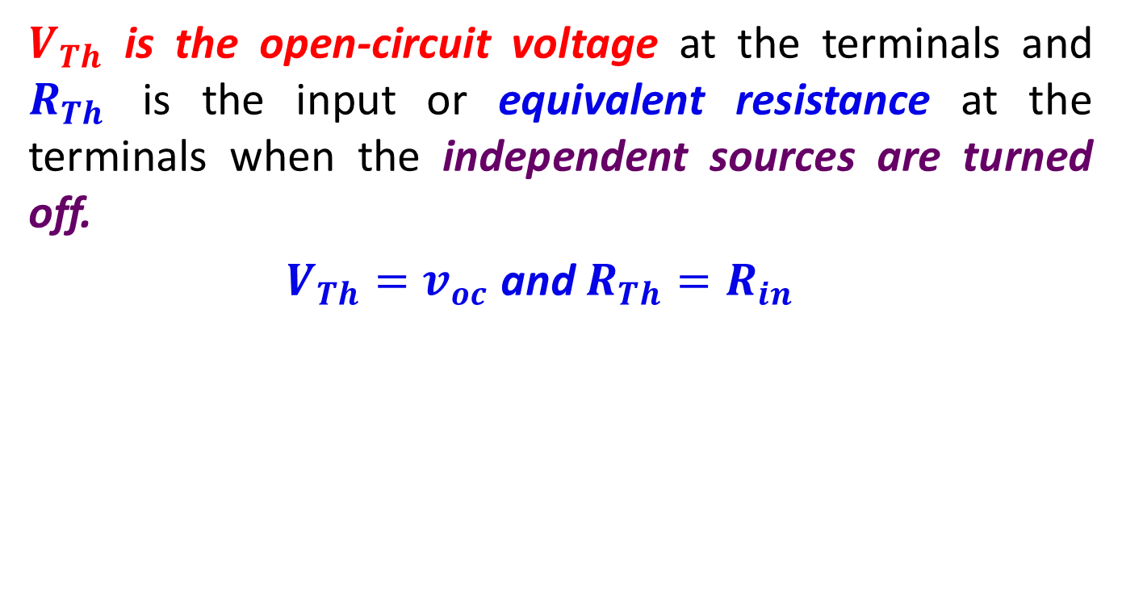

Thevenin’s Theorem
$V_{Th}$ is the open-circuit voltage at the terminals and $R_{Th}$ is the input or equivalent resistance at the terminals when the independent sources are turned off.
$V_{Th}=v_{oc}$ and $R_{Th}=R_{in}$
Figure: Finding $V_{Th}$and $R_{Th}$.

Slide 22
The following steps provide a technique that converts any circuit into its Thévenin equivalent:
Identify and remove the load resistance from the circuit and label the resulting two terminals as a and b.
Determine the open-circuit voltage between the terminals a and b. superposition theorem may use if the circuit has more than one source.
Set all sources in the circuit to zero: Voltage sources are set to zero by replacing them with short circuits (zero volts). Current sources are set to zero by replacing them with open circuits (zero amps).

Slide 23
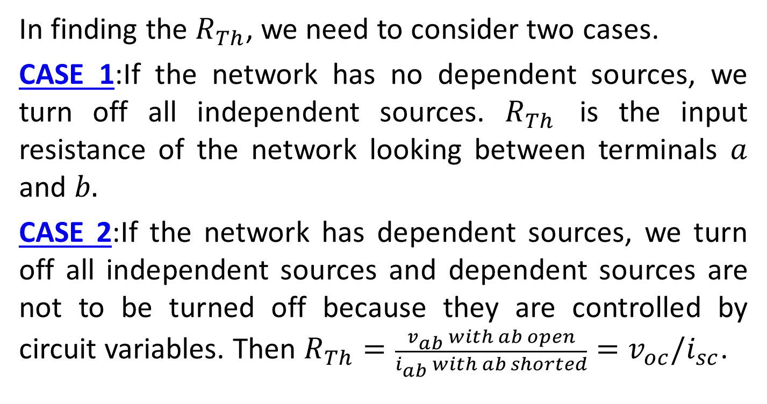
Thevenin’s Theorem
In finding the $R_{Th}$, we need to consider two cases.
CASE 1:If the network has no dependent sources, we turn off all independent sources. $R_{Th}$ is the input resistance of the network looking between terminals $a$ and $b.$
CASE 2:If the network has dependent sources, we turn off all independent sources and dependent sources are not to be turned off because they are controlled by circuit variables. Then $R_{Th}={\frac{v_{ab} with ab open}{i_{ab} with ab shorted}=v}_{oc}/i_{sc}$.

Slide 24
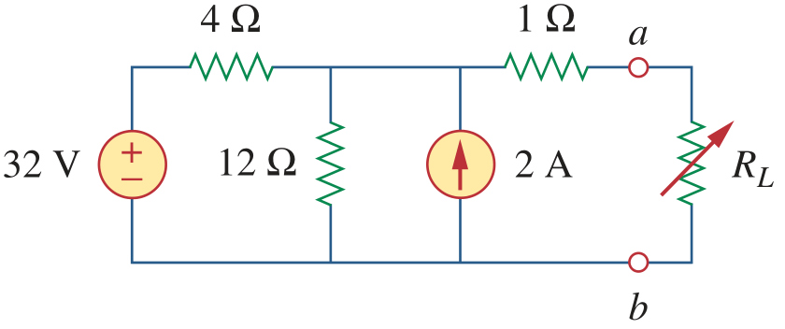
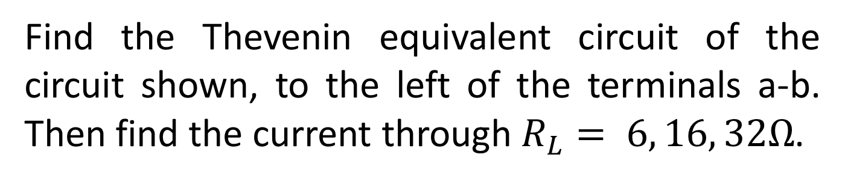
Example
Find the Thevenin equivalent circuit of the circuit shown, to the left of the terminals a-b. Then find the current through $R_{L}= 6, 16, 32Ω$.

Slide 25
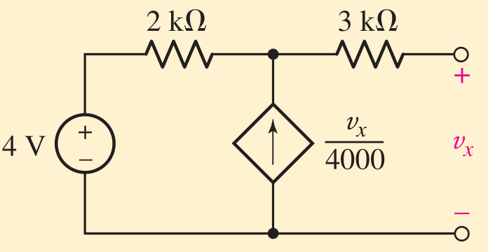
Example
Determine the Thévenin equivalent of the circuit shown.

Slide 26
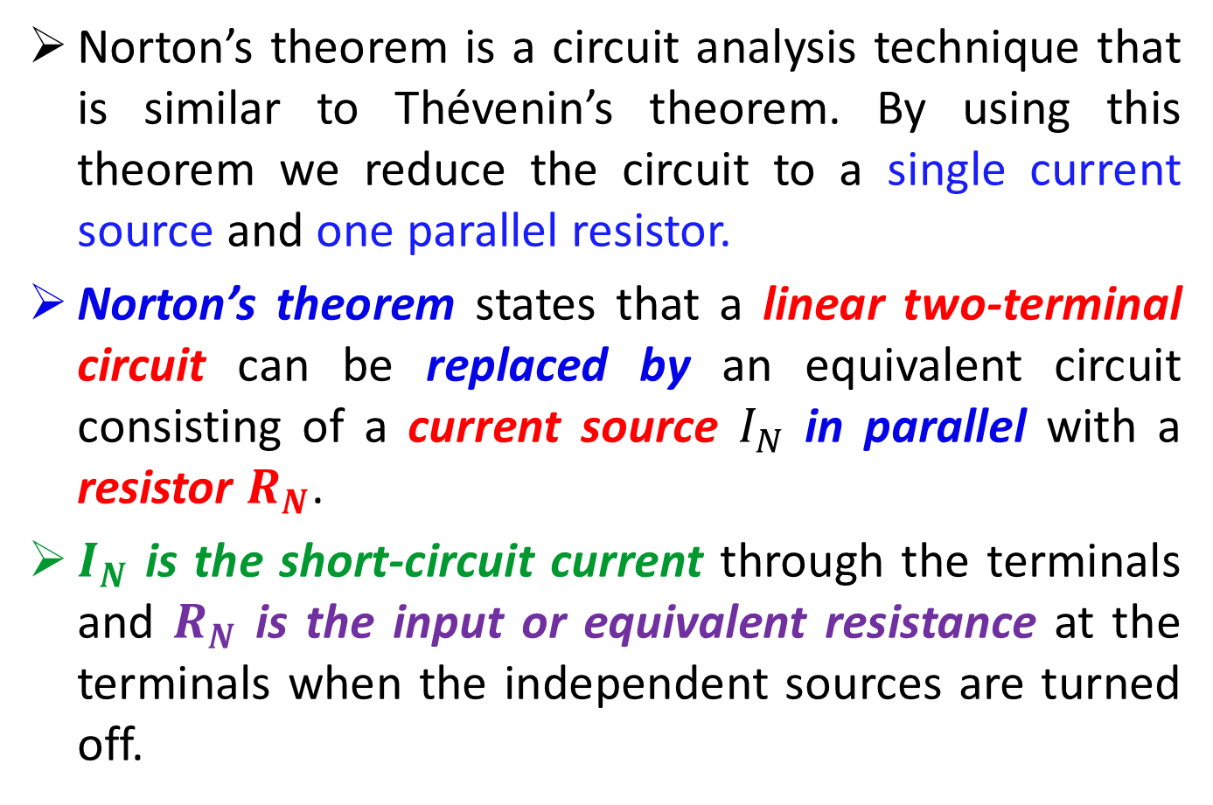
Norton’s Theorem
Norton’s theorem is a circuit analysis technique that is similar to Thévenin’s theorem. By using this theorem we reduce the circuit to a single current source and one parallel resistor.
Norton’s theorem states that a linear two-terminal circuit can be replaced by an equivalent circuit consisting of a current source $I_{N}$ in parallel with a resistor $R_{N}$.
$I_{N}$ is the short-circuit current through the terminals and $R_{N}$ is the input or equivalent resistance at the terminals when the independent sources are turned off.

Slide 27
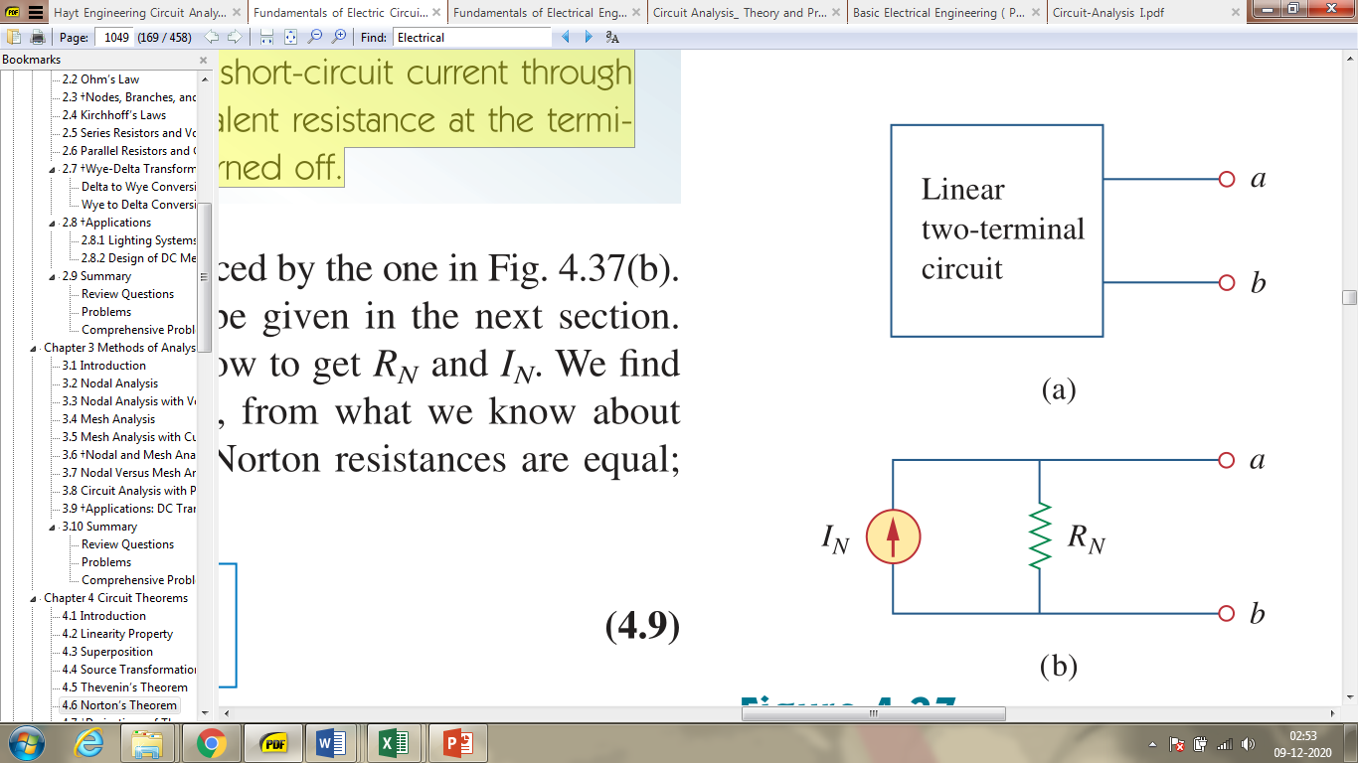
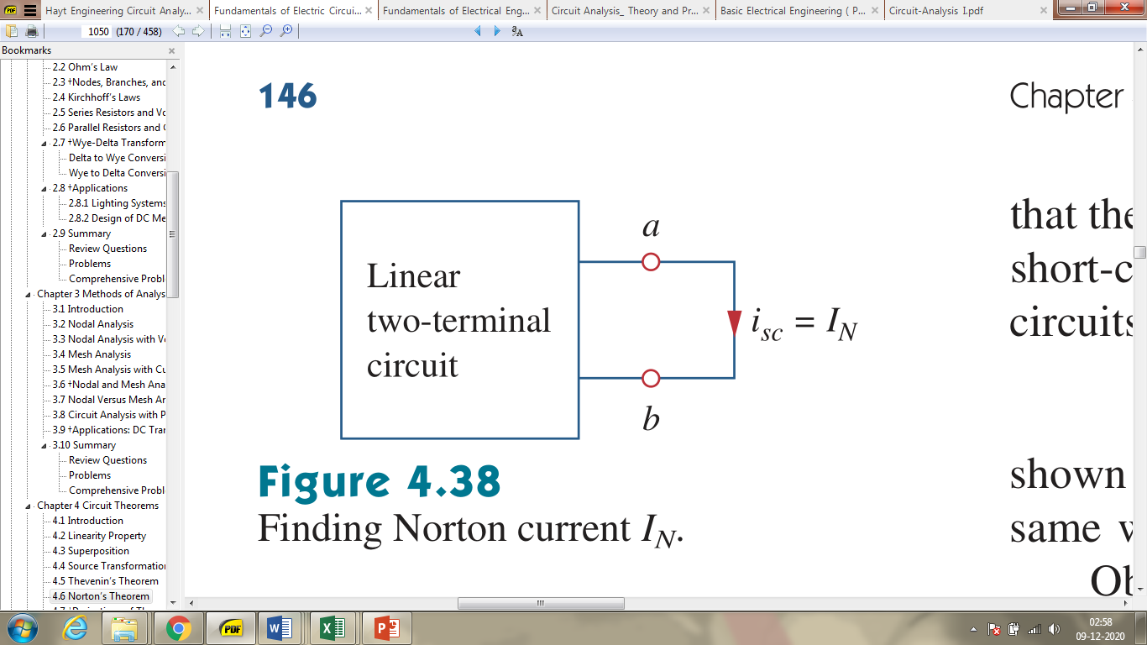
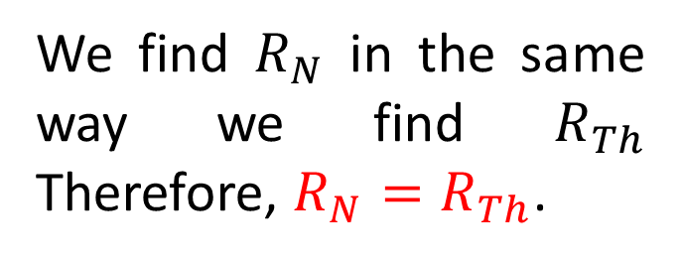
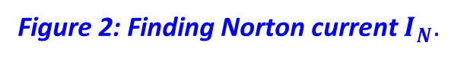
Norton’s Theorem
Figure 2: Finding Norton current $I_{N}.$
We find $R_{N}$ in the same way we find $R_{Th}$ Therefore, $R_{N}=R_{Th}$.
Figure 1: (a) Original circuit, (b) Norton equivalent circuit.

Slide 28
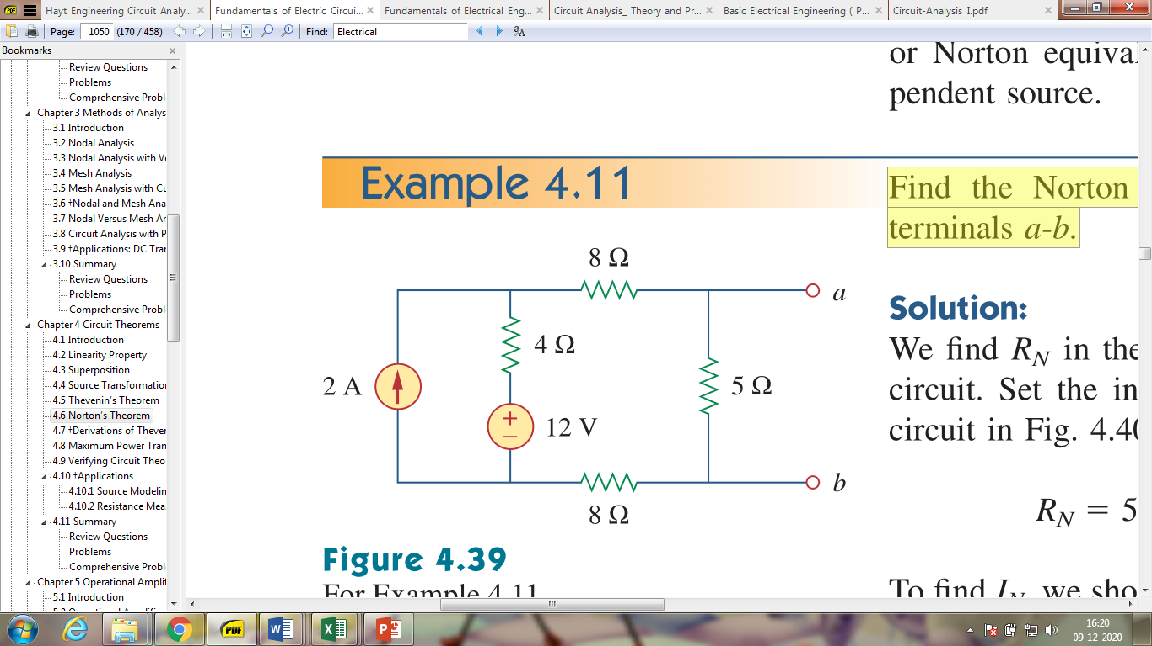
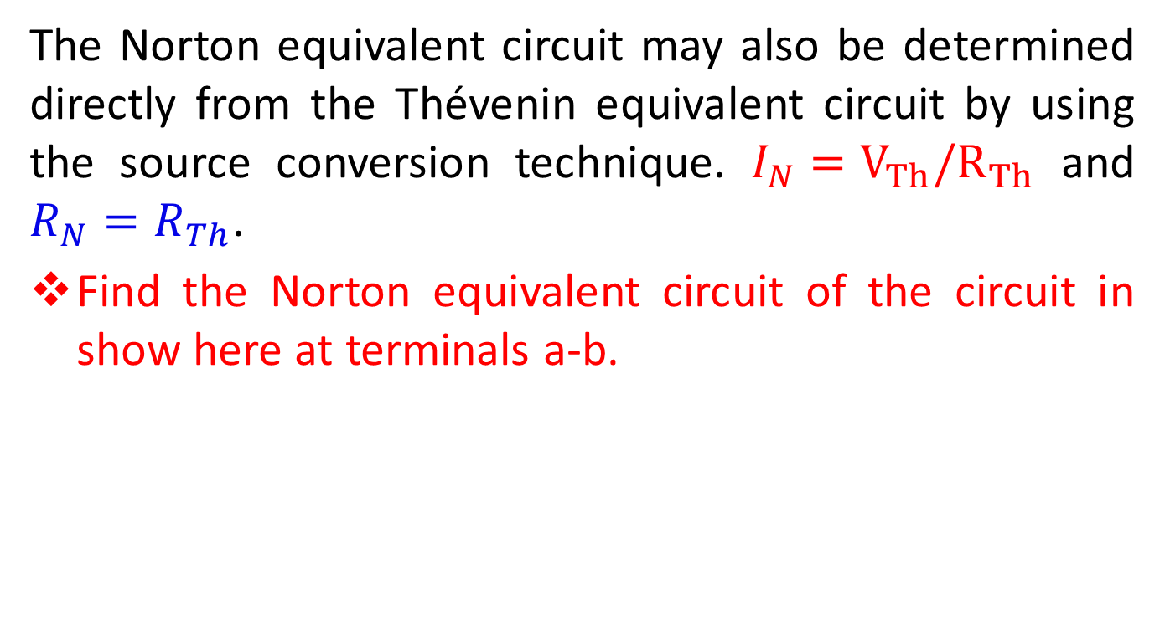
Norton’s Theorem
The Norton equivalent circuit may also be determined directly from the Thévenin equivalent circuit by using the source conversion technique. $I_{N}=V_{Th}/R_{Th}$ and $R_{N}=R_{Th}$.
Find the Norton equivalent circuit of the circuit in show here at terminals a-b.

Slide 29
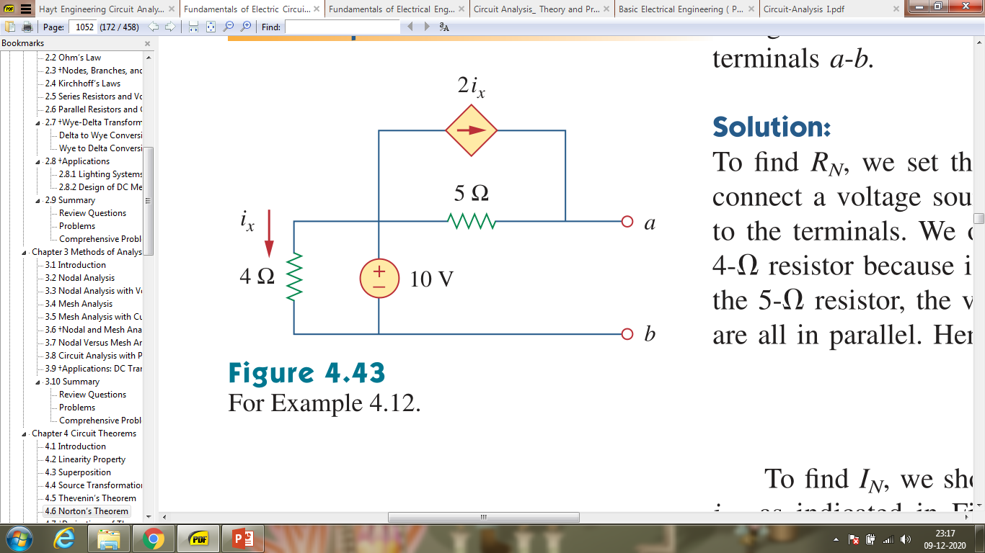
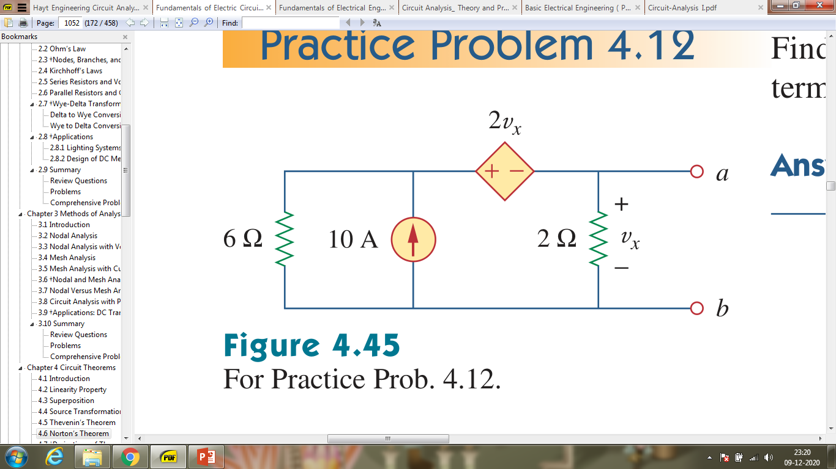
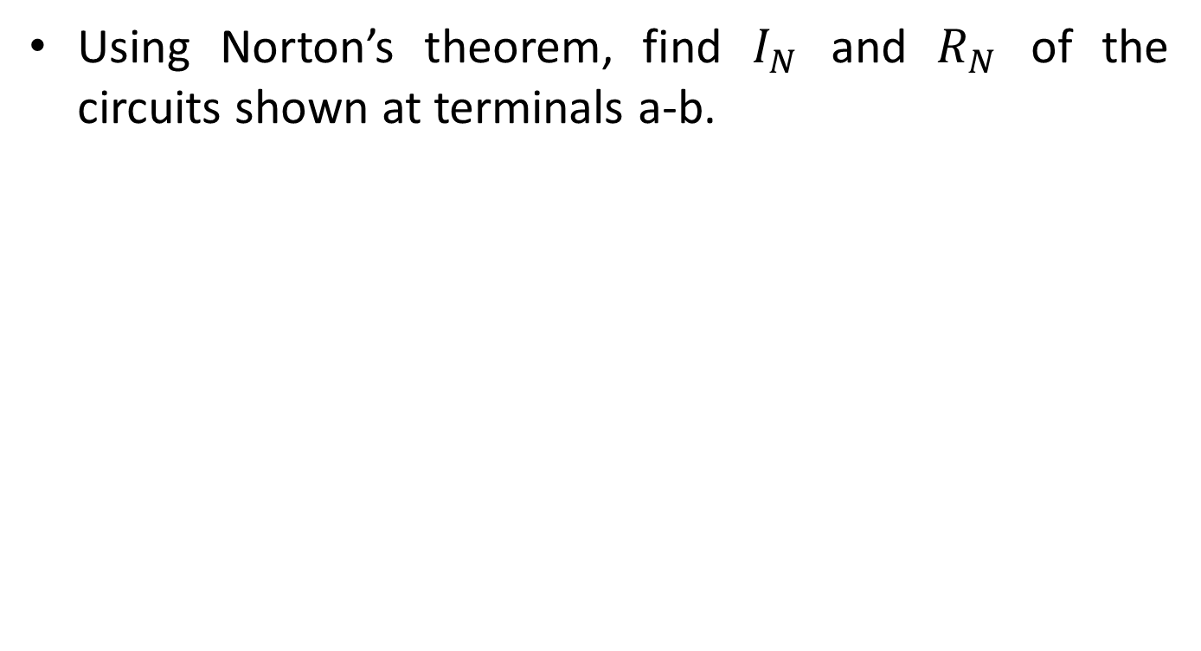
Practice Problem
Using Norton’s theorem, find $I_{N}$ and $R_{N}$ of the circuits shown at terminals a-b.
Figure: Example one
Figure: Example two

Slide 30
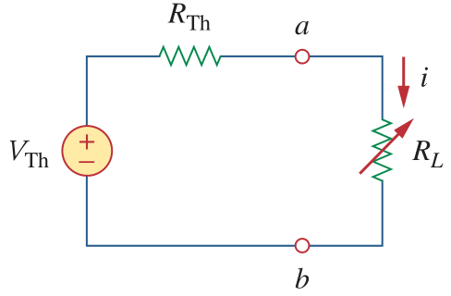
Maximum Power Transfer Theorem
The maximum power transfer theorem states
A load resistance will receive maximum power from a circuit when the resistance of the load is exactly the same as the Thévenin (Norton) resistance looking back at the circuit.
The Thevenin equivalent is useful in finding the maximum power a linear circuit can deliver to a load.
Figure: The circuit used for maximum power transfer.

Slide 31
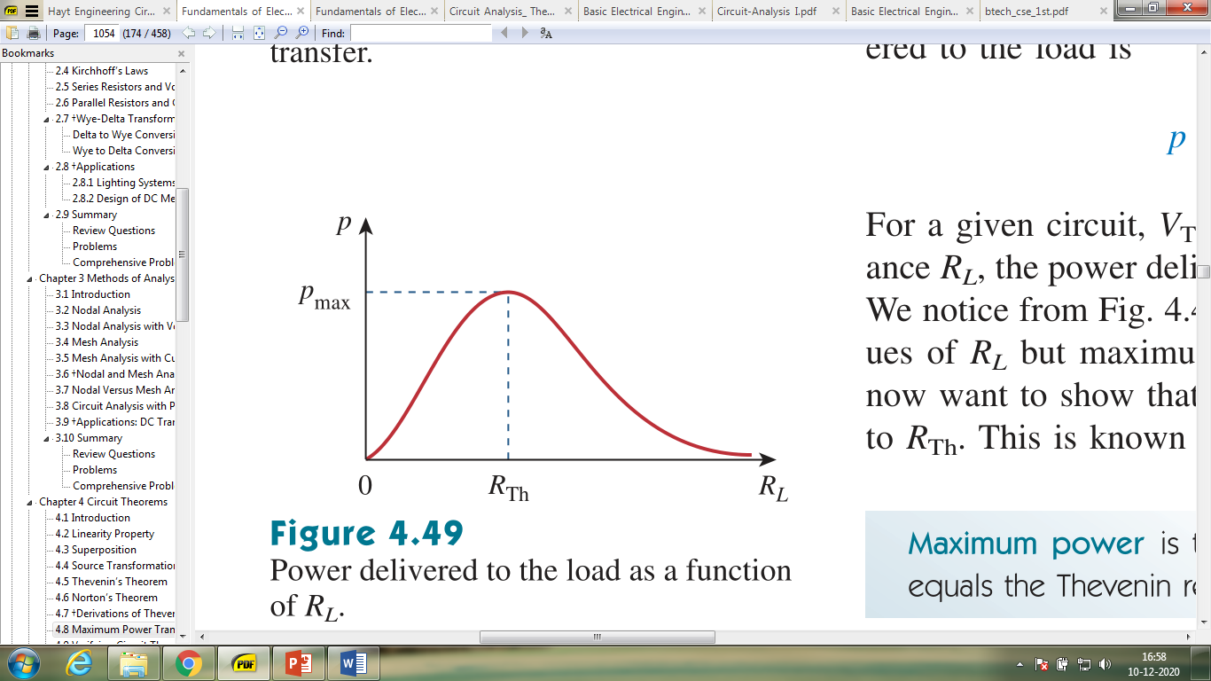
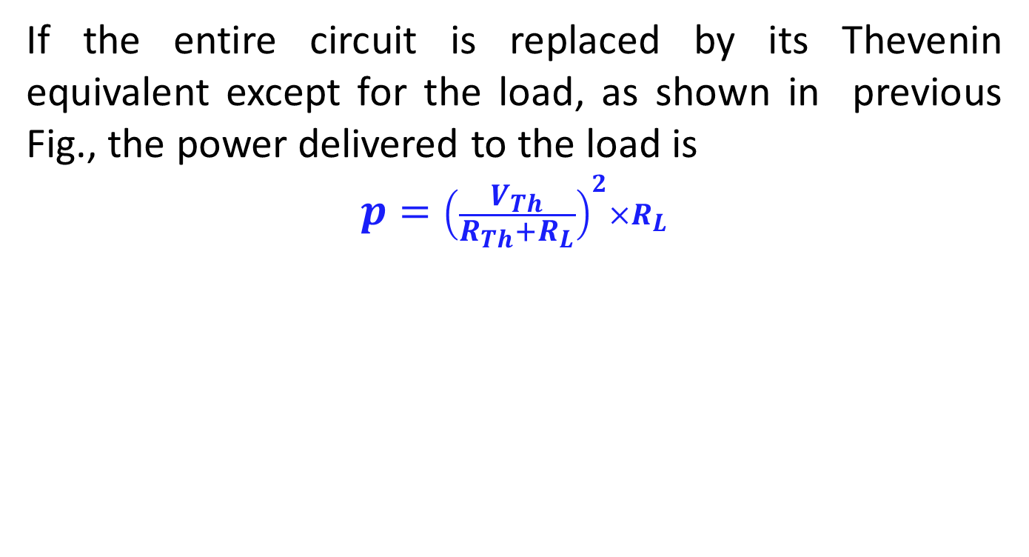
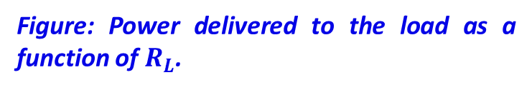
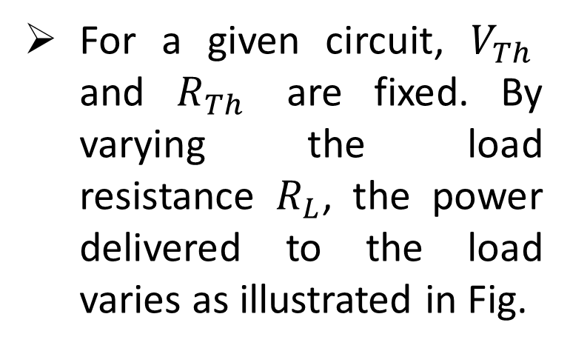
Maximum Power Transfer Theorem
If the entire circuit is replaced by its Thevenin equivalent except for the load, as shown in previous Fig., the power delivered to the load is
$$p={\left(\frac{V_{Th}}{R_{Th}+R_{L}}\right)}^{2}×R_{L}$$
For a given circuit, $V_{Th}$ and $R_{Th}$ are fixed. By varying the load resistance $R_{L}$, the power delivered to the load varies as illustrated in Fig.
Figure: Power delivered to the load as a function of $R_{L}$.

Slide 32
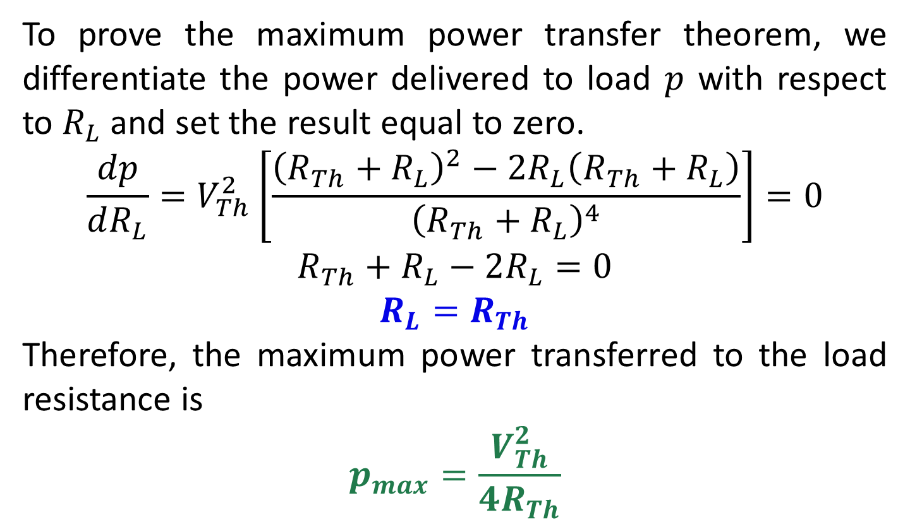
Maximum Power Transfer Theorem
To prove the maximum power transfer theorem, we differentiate the power delivered to load $p$ with respect to $R_{L}$ and set the result equal to zero.
$$\frac{dp}{dR_{L}}=V_{Th}^{2}\left[\frac{{\left(R_{Th}+R_{L}\right)}^{2}−2R_{L}\left(R_{Th}+R_{L}\right)}{{\left(R_{Th}+R_{L}\right)}^{4}}\right]=0$$
$$R_{Th}+R_{L}−2R_{L}=0$$
$$R_{L}=R_{Th}$$
Therefore, the maximum power transferred to the load resistance is
$$p_{max}=\frac{V_{Th}^{2}}{4R_{Th}}$$

Slide 33
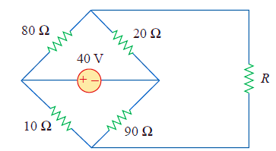
The variable resistor R in Fig. below is adjusted until it absorbs the maximum power from the circuit.
(a) Calculate the value of R for maximum power.
(b) Determine the maximum power absorbed by R.

Slide 34
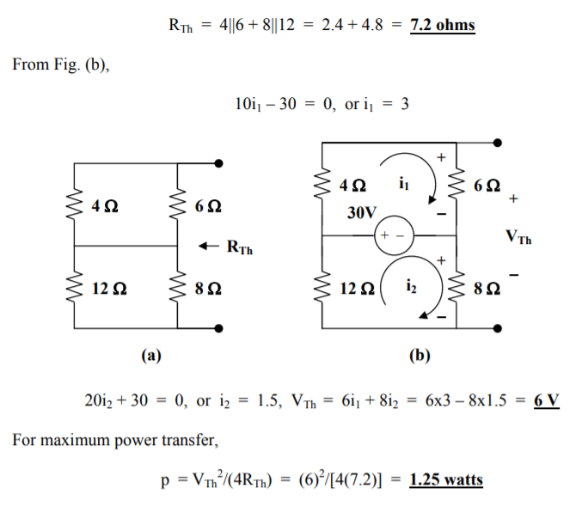

Slide 35
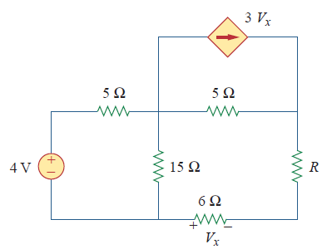
Determine the maximum power delivered to the variable resistor R shown in the circuit of Fig.

Slide 36
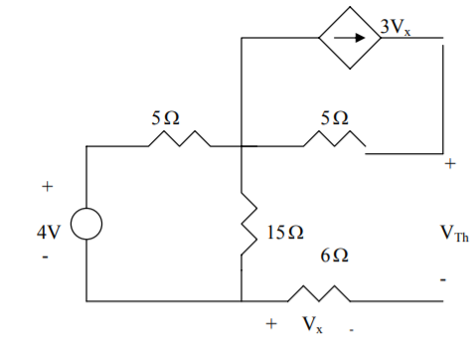
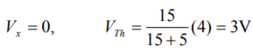


Slide 37




Slide 38

Reciprocity Theorem
The reciprocity theorem is a theorem that can only be used with single-source circuits. However, this theorem may be applied to either voltage sources or current sources.
Reciprocity theorem for voltage sources: A voltage source causing a current $I$ in any branch of a circuit may be removed from the original location and placed into that branch having the current $I$. The voltage source in the new location will produce a current in the original source location that is exactly equal to the originally calculated current, $I$.

Slide 39
Reciprocity Theorem
When applying the reciprocity theorem for a voltage source, the following steps must be followed:
The voltage source is replaced by a short circuit in the original location.
The polarity of the source in the new location is such that the current direction in that branch remains unchanged.

Slide 40


Practice Problem 1
Consider the circuit of Figure shown here:
Calculate the current$I$.
Remove voltage source $E$ and place it into the branch with $R_{3}$ . Show that the current through the branch which formerly had $E$ is now the same as the current$I$.

Slide 41


Practice Problem 1 (Continuation)
After removing the voltage source from its original location and moving it into the branch containing the current $I$, we obtain the circuit shown here.

Slide 42
Reciprocity Theorem: Current Source
For Current Sources: A current source causing a voltage V at any node of a circuit may be removed from the original location and connected to that node. The current source in the new location will produce a voltage in the original source location that is exactly equal to the originally calculated voltage, V.
The following conditions must be met:
1. The current source is replaced by an open circuit in the original location.
2. The direction of the source in the new location is such that the polarity of the voltage at the node to which the current source is now connected remains unchanged.

Slide 43


Practice Problem2
Consider the circuit shown in Figure below:
Determine the voltage $V$ across resistor $R_{3}$.
Remove the current source $I$ and place it between node b and the reference node. Show that the voltage across the former location of the current source (node a) is now the same as the voltage $V$.

Slide 44

Practice Problem 2 (Continuation)
After relocating the current source from the original location, and connecting it between node b and ground, we obtain the circuit shown here.

